Slide 1
Feet & Ankles
Day 1
Review the relevant anatomy for the lower leg and learn to assess client foot shapes and alignment patterns
Define neutral and efficient foot & ankle alignments and gaits
Learn and practice observing inefficient gait patterns and how they might affect knees, hips, back, shoulders, and neck

Slide 2
Ideal Efficient Foot & Ankle Alignments
When properly aligned, the feet and knees should point forward in space with the ankle, knee, and hip joints on a plumb line in gravity
In addition, the ankle should be able to hinge without the knee or hip externally (or internally) rotating to compensate for a lack of mobility
The talar-calcaneal joint (often called the subtalar joint) should have good mobility to allow the calcaneus to evert and invert when shifting weight from one leg to the other
When these joints and structures are misaligned or lacking proper mobility (or stability) the knees, hips, and lumbar spine overcompensate resulting in long term wear and tear issues to these joints

Slide 3
Ideal Efficient Foot & Ankle Alignments (cont)
Ideally, feet point forward in the direction a person is walking
The foot arch can take many forms but should act as a shock absorber in walking and running. It should be able to compress on impact then spring back as weight shifts off the foot.
Toes should continue in the same line as the metatarsals and have mobility to extend back to keep contact and balance with the floor as the heel lifts into the next step

Slide 4
When the ankle hinges correctly the knees and hips move efficiently and easily
Older ankle sprains can cause the ankle joint to compensate by improperly hinging along a diagonal instead of straight back towards the knee (which involves over eversion and inversion)
When this diagonal hinging occurs, the natural forward motion of walking and running become diagonal “speed skating” movements
These diagonal movements place extra wear and tear twisting on the knees and hips.
Over the long term this can lead to bunions, plantar fasciitis, cartilage loss in the knees, meniscus tearing in the knees, hypertonic hip external rotators, and other issues

Slide 5
Anatomy: Major Bones & Cartilage of the Lower Leg
Tibia
Fibular
Talus
Calcaneus
Cuboid
Navicular
Lateral, intermediate, medial cuneiforms
Metatarsals 1-5
Phalanges (proximal, middle, distal)

Slide 6
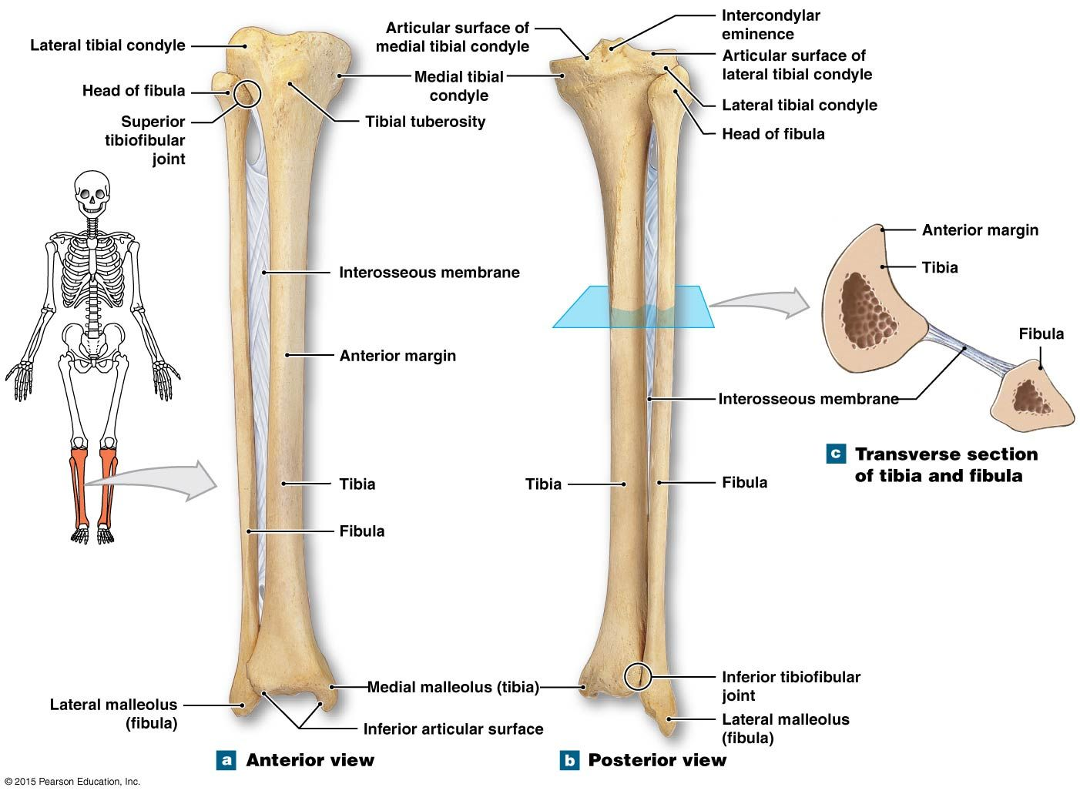

Slide 8
Anatomy Review: Major Joints of the Ankle & Foot
Talocrural Joint (Ankle Joint) - Hinge
Subtalar Joint (Talocalcaneal Joint) - Sliding
Transverse Tarsal Joints - Synovial
Metatarsophalangeal Joints - Condyloid & Synovial

Slide 9
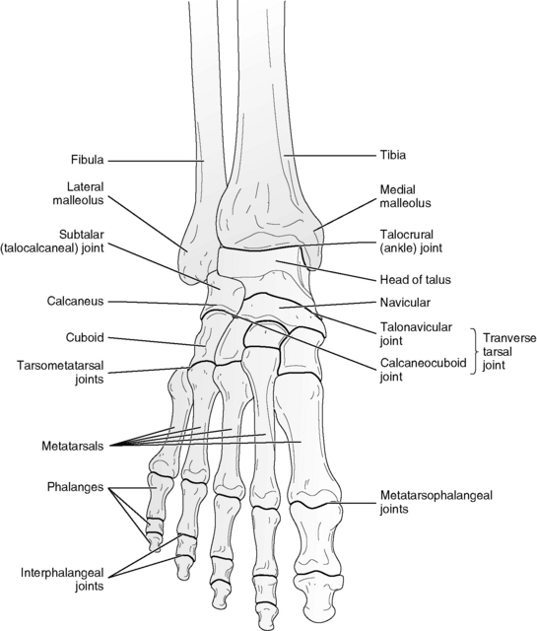

Slide 10
Anatomy Review: Major Bony Landmarks Most Relevant to Manual Therapy of Lower Leg
Tibial Tuberosity
Head of the Fibula
Interosseous Membrane between Tibia & Fibula
Medial & Lateral Malleolus
Medial & Lateral sides of the Calcaneus
Medial edge of the Navicular
Head of the 5th Metatarsal
“Met-Heads” (ie balls of the feet)

Slide 11
Three Muscle Compartments Control the Ankle, Foot, and Toes - Anterior, Posterior, and Lateral
Posterior Compartment Muscles
Gastrocnemius
Soleus
Popliteus
Plantaris
Flexor Digitorum Longus
Flexor Hallucis Longus
Tibialis Posterior
Anterior Compartment Muscles
Tibialis Anterior
Extensor Digitorum Longus
Extensor Hallucis Longus
Lateral Compartment Muscles
Peroneus Longus
Peroneus Brevis
(sometimes called Fibularis)

Slide 12
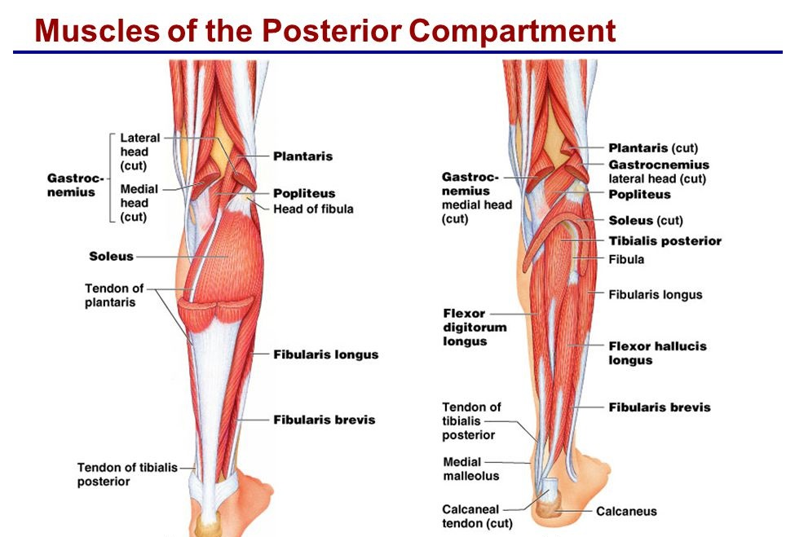

Slide 13
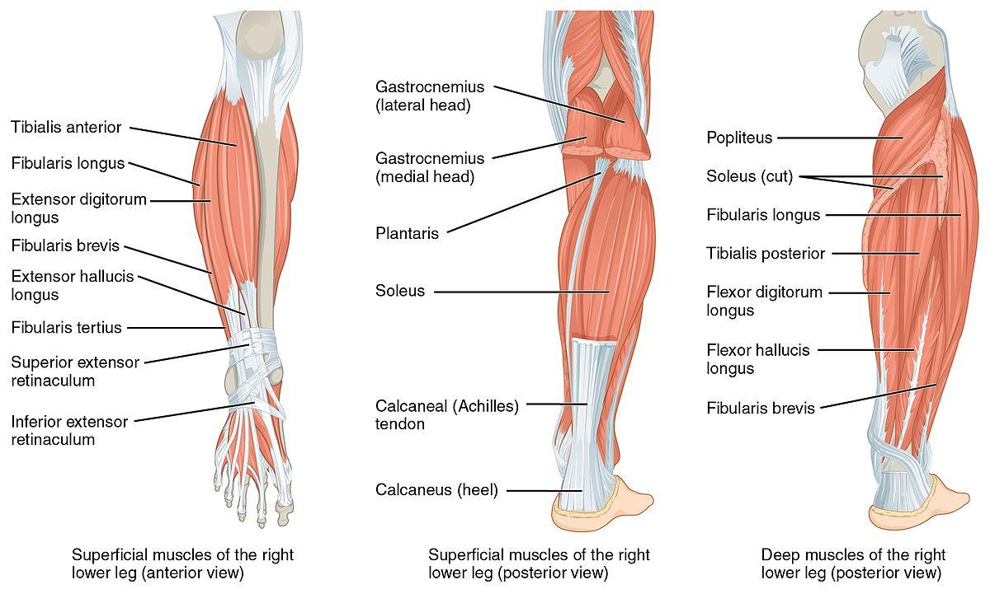

Slide 14
Relevant Techniques Beyond Muscle Stripping
Cross fiber friction on tendons to active golgi tendon organ reflex
This can be especially useful to allow deeper and hard to get at muscles such as digitorum and hallucis muscles to release
Also useful at the cross sites of gastrocnemius and the hamstring tendons
Cross fiber friction on tendon sheaths under retinaculum to assist tendons in properly sliding through the sheaths where they can often get fascial adhesions

Slide 15
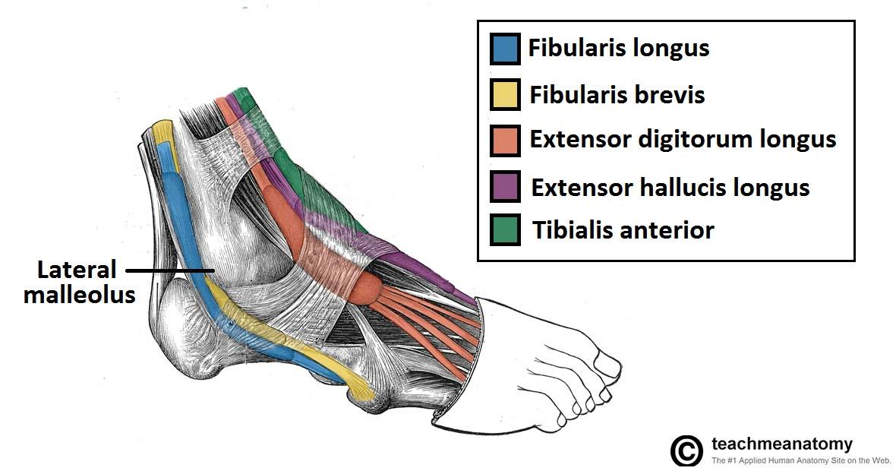

Slide 16
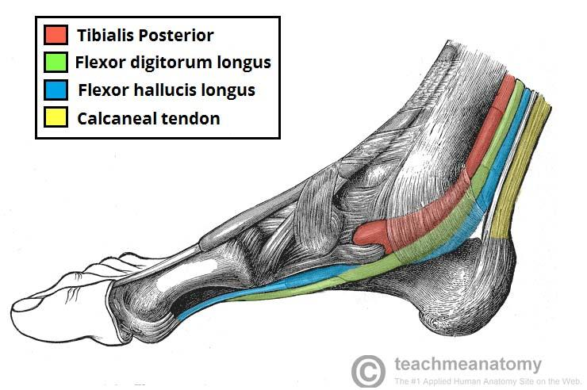

Slide 17
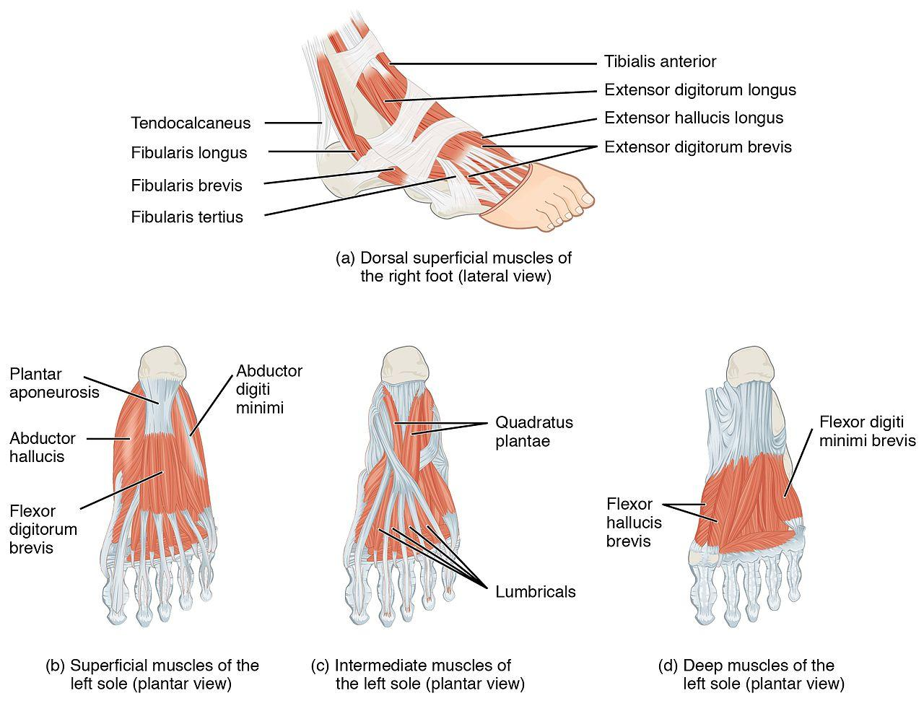

Slide 19
Basic Construction of the Foot Arch & Ankle Joint
The foot arch should form a set of 4 points that ideally exist on the same “plane,” the two met-heads, and the inside and outside of the calcaneus
The plane of the arch should be able to comfortably sit parallel to the floor when standing
The ankle joint should then be able to hinge in a straight line towards the knee and away from the knee without altering the alignment of the foot arch plane
Lastly, the subtalar joint should be free to slide into eversion/inversion to allow the weight to shift easily from one foot to the other when walking or running

Slide 20
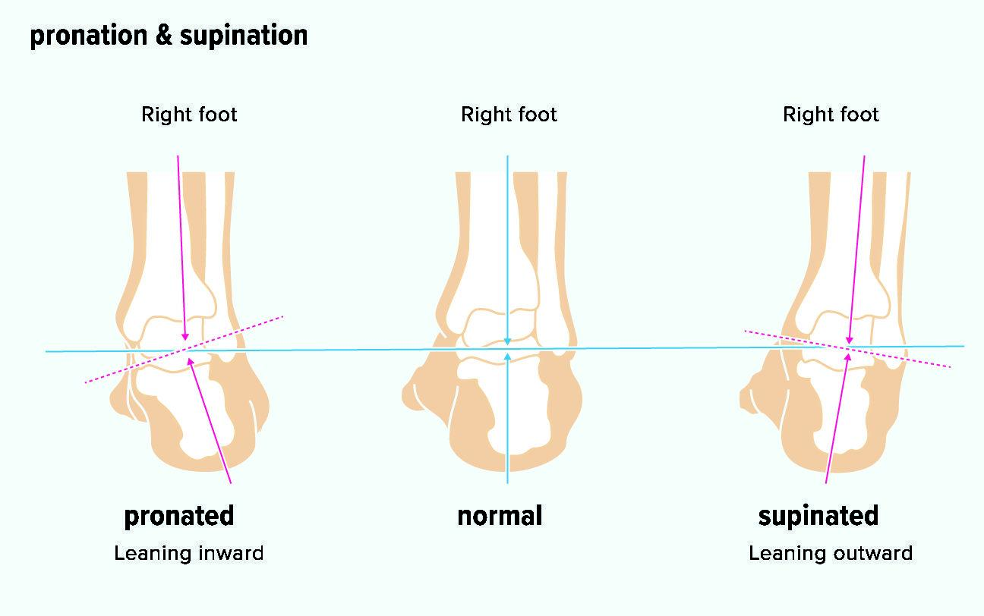
Assessing Alignment Patterns: Calcaneal Position

Slide 21
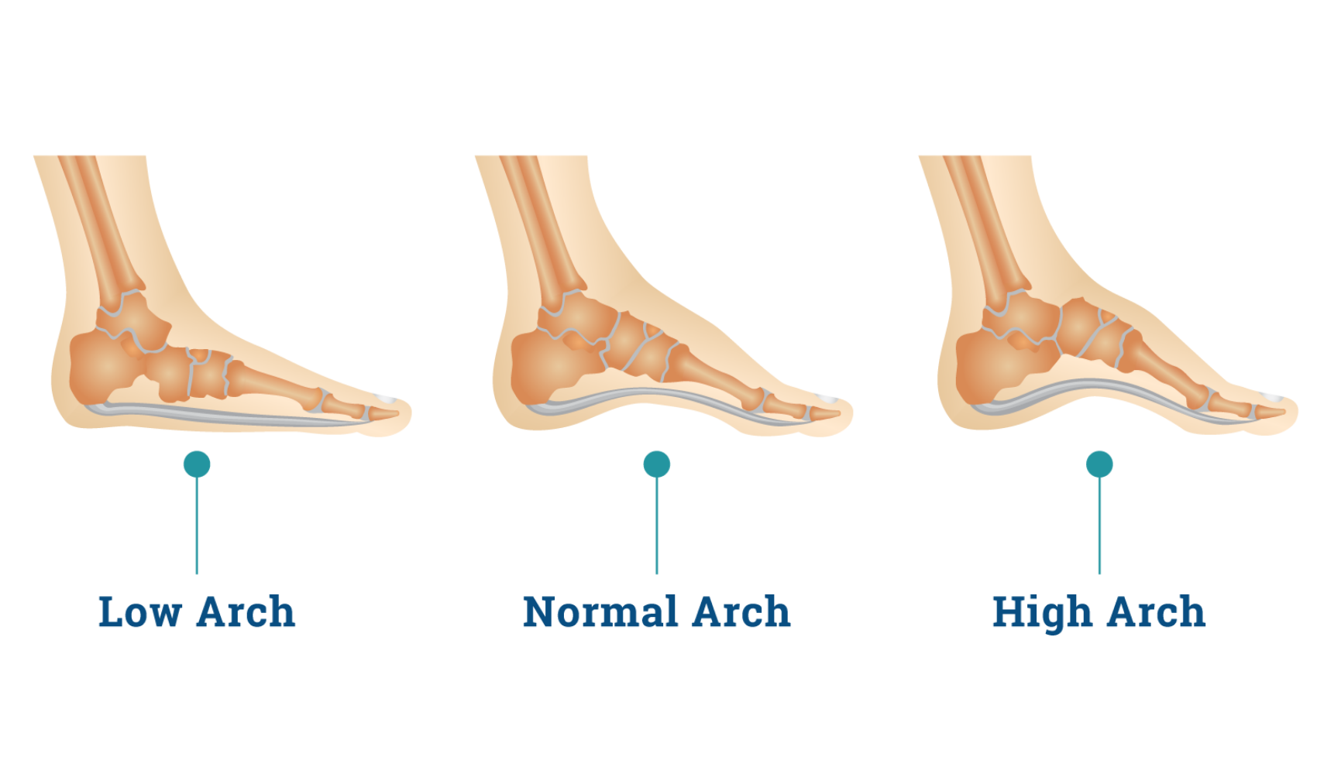
Assessing Alignment Patterns: Metatarsal Positions (ie arch shape)

Slide 22
Assessing Alignment Patterns: Combined Arch & Calcaneal Positions
Pronated Calcaneus + Fallen Arch
Neutral Calcaneus + Fallen Arch
Neutral Calcaneus + Neutral Arch (ideal)
Supinated Calcaneus + Neutral Arch
Neutral Calcaneus + High Arch
Supinated Calcaneus + High Arch

Slide 23
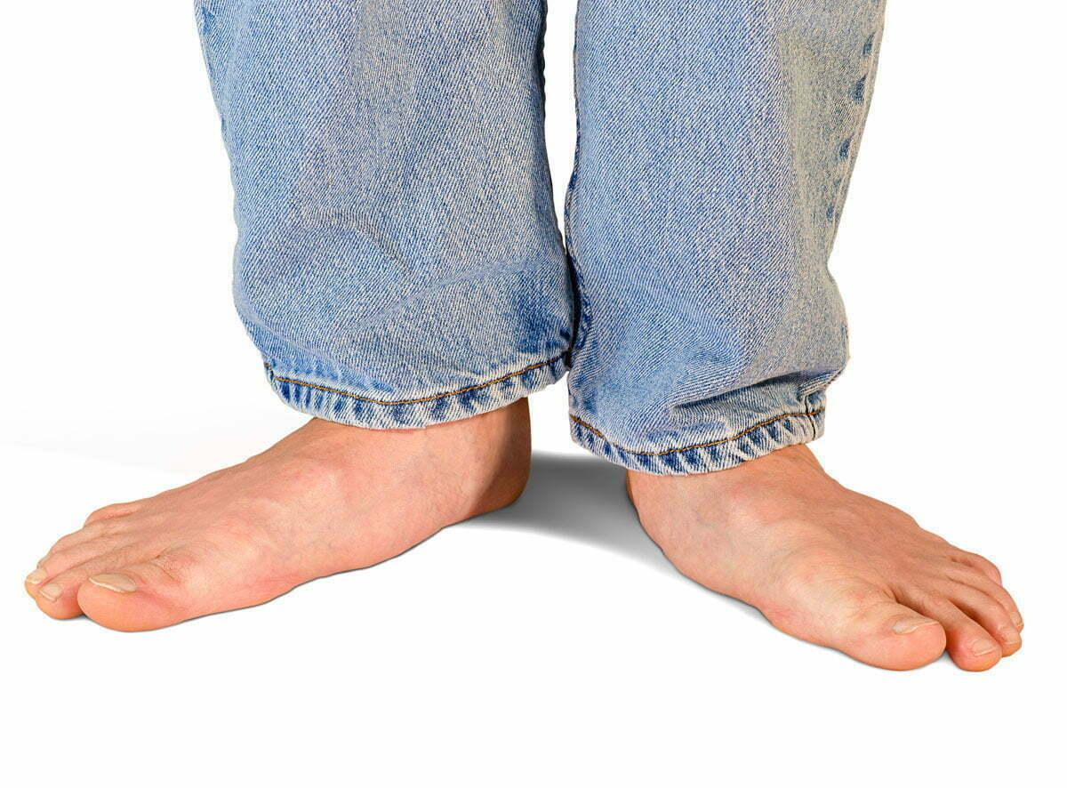
Example #1 - Pronated Calcaneus + Fallen Arch

Slide 24
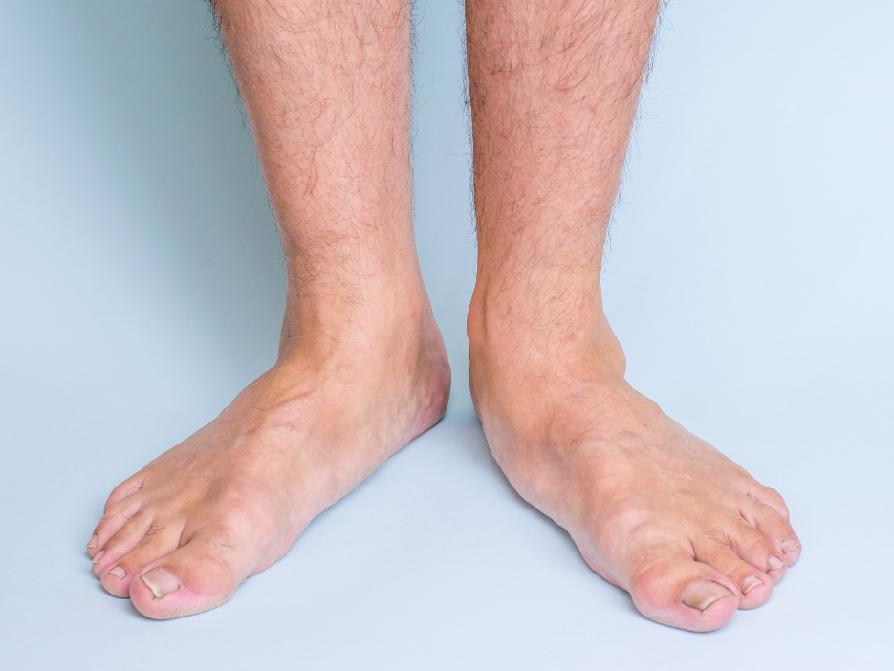
Example #2 - Neutral Calcaneus + Fallen Arch (right foot)

Slide 25
Example #3 - Supinated Calcaneus + High or Neutral Arch

Slide 26
Assessing Alignment Patterns: Toe Position and Functionality
Toes should be aligned with their corresponding metatarsal
They should also be able to separate from each other and spread, and flex and extend to a reasonable degree
The big toe acts as a final balance point on the back foot before completely shifting weight to the front in walking and running
Bunions and/or broken or crushed sesamoid bones may cause the ankle to invert to take weight off of the medial met head

Slide 27
Possible Symptoms Due to Foot & Ankle Misalignments
Plantar Fasciitis
Heel Strike Pain
Bone Spur at front of calcaneus at attachment of plantar fascia
Achilles Tendonitis
Bunions
Hammer Toes
Overlapping Toes
Shin Splints
Broken or crushed sesamoid bones under big toe

Slide 28
Assessing Gait Patterns
Proper gait should have the foot, ankle, and knees facing and moving forward in the direction you are moving
The ankle joint should hinge well without causing internal or external rotation of the knee and/or hip
The talar-calcaneal joint should slide slightly to allow the ankle to pivot when shift weight from one foot to the other

Slide 29
Assessing Gait Patterns: Basics
Look for inefficient motion in the gait which causes movement away from easy gliding in the forward direction
This can look like side to side motion, bouncing up/down motion, diagonal motion, etc.
Motion that shows up in the upper carriage that isn’t easy gliding forward with arms gently swinging is an indication of improper ankle hinging, a lack of talar-calcaneal sliding, and/or an inability to roll through the foot and the big toe

Slide 30
Assessing Gait Patterns: The “Penguin”
Both feet turned out
Tight hips with a lack of knee hinging
Noticeable side to side rocking of the upper carriage
A sense that the leg needs to be lifted by hiking the hip instead of flexing the hip

Slide 31
Assessing Gait Patterns: “Limping”
One foot turned out
Opposite arm held so that it doesn’t swing (usually opposite, sometimes same side, like they are still holding a cane)
One side seems to dip and shift diagonally

Slide 32
Assessing Gait Patterns: “Marching”
High knees and or lots of arm swing, especially at the elbow
A lack of twisting motion in the spine and pelvis
Heavy footfalls

Slide 33
Assessing Gait Patterns: “Speed Skating”
Noticeable diagonal movement with each step
Arms cross over body and swing out to sides
Possibly a lean forwards

Slide 34
Assessing Gait Patterns: “Drop Foot or Feet”
Noticeable dragging of one or both feet
Arms likely held up higher (or shoulders shrugged) for balance
Eyes pointed towards floor

Slide 35
Assessing Gait Patterns: “Toe Walking”
Noticeable bouncing up/down movement of the upper carriage
A sense that the heels don’t really land
High arm swing likely

Slide 36
Assessment Practice
Body reading on basic foot shapes with each other
Looking for how foot shapes affect knees, hips, and upper carriage with each other
Practice assessing each others’ gaits

Slide 37
Feet & Ankles
Day 2
Goal setting concepts for lower leg sessions
Treatment demonstrations in prone, side lying, and supine positions
Review of homework practices to give clients post session

Slide 38
Common Goals for Lower Leg Sessions
Fascially separate anterior, lateral, and posterior compartments in the lower leg so that they can function independently
Lift or lengthen one or both arches towards a more neutral position
Free the talar-calcaneal joint to allow for proper sliding and to shift foot backwards slightly if there is no discernible curve in the achilles
Align the calcaneus to be in line with tibia vertically
With calcaneus aligned in a neutral position, work towards the two met heads being perpendicular to the vertical plumb midline of the body
Free up the ankle joint to allow for useful hinging that has decent ROM without causing the knee and hip to rotate internally or externally

Slide 39
Special Goals for Lower Leg Sessions
For hypermobile clients, giving single leg balance exercises that will help the intrinsic foot muscles strengthen and better stabilize the foot
For hypomobile clients, working to soften and stretch the intrinsic foot muscles to allow for more shock absorption
With a noticeably externally rotated lower leg, freeing the 2nd head of biceps femoris and also any fascial adhesions to the gastroc and hamstring tendons where they cross at the knee

Slide 40
Consider spending all 60 minutes on just the lower leg
Ankle sprains and toe injuries are often the very first injuries we have in life and the compensations left over from those first injuries can make all of the musculature stuck together
With most clients, it can take an entire 60 minutes to truly work through and free up long standing adhesions and patterns enough to create an impactful change - which in turn can allow all the rest of the musculature to soften up and work less for balance
Getting a solid and useful foundation that provides both mobility and stability will make all future work you do to the rest of the body easier and more likely to “stick” long term

Slide 41
Proposed Treatment Sequence: 60 minutes on just the lower leg, 40 minutes in prone, 20 minutes in supine
Prone Sequence
Undrape both lower legs up to the knee
First, try to align the legs so that they are parallel to the midline of the body and the ankle, knee, and hip joints land on a line that would be a plumb line if the client were standing
Visually assess if the lower leg is internally or externally rotated on one or both sides
Visually assess if the ankle(s) “fall in” ie show inversion, or in rarer cases eversion

Slide 42
Proposed Treatment Sequence: 60 minutes on just the lower leg, 40 minutes in prone, 20 minutes in supine
Prone Sequence (cont)
Starting at the foot, draw fascial lines through the inside arch, outside arch, and transverse arches of the foot using the forearm or soft fist
Using a knuckle, draw a fascial stroke from the front of the calcaneus down through the space between the 4th & 5th metatarsals to help free up the outside arch

Slide 43
Proposed Treatment Sequence: 60 minutes on just the lower leg, 40 minutes in prone, 20 minutes in supine
Prone Sequence (cont)
Starting at the medial condyle of the tibia, draw a fascial stroke down towards ankle along the edge of the tibia aiming for release of tibialis posterior using thumb or elbow
Draw a line parallel to this starting slightly away from the tibia
Continue to draw lines from knee to ankle moving in an arc from inside of the knee to outside feeling for any adhesions and taking extra time on these to allow them to melt and release (should be roughly 10-12 lines)

Slide 44
Proposed Treatment Sequence: 60 minutes on just the lower leg, 40 minutes in prone, 20 minutes in supine
Prone Sequence (cont)
Lift the lower leg and use gentle rocking to shake out the musculature and rock the ankle
If the lower leg is externally rotated, apply release to 2nd head of biceps femoris
Put the lower leg back on table
Repeat fascial stroke from front of calcaneus through 4th & 5th metatarsals, going deep this time to contact and release abductor digiti minimi
Repeat entire sequence on the other leg
This entire prone sequence should take roughly 40 minutes

Slide 45
Proposed Treatment Sequence: 60 minutes on just the lower leg, 40 minutes in prone, 20 minutes in supine
Supine Sequence
Have the client turn over, sliding bolster higher and under knees
Using the foot as a lever to keep leg in place, using fascial release strokes from knee to ankle starting at top of tibialis anterior where it meets the shin
Repeat these strokes working laterally a bit at a time to free up the anterior compartment (roughly 4-6 strokes)

Slide 46
Proposed Treatment Sequence: 60 minutes on just the lower leg, 40 minutes in prone, 20 minutes in supine
Supine Sequence (cont)
Work up from ankle to head of the fibula using fascial release strokes on peroneus brevis and longus
Both of the lateral compartment muscles are likely fascially “cemented” to the fibula due to older inversion ankle sprains
Use cross fiber friction down through each to help soften adhesions and free the muscles from the anterior and posterior compartment musculature

Slide 47
Proposed Treatment Sequence: 60 minutes on just the lower leg, 40 minutes in prone, 20 minutes in supine
Supine Sequence (cont)
Use cross fiber friction on the anterior retinaculum asking client to flex and extend their toes and ankle to help the anterior tendons move freely through the sheaths of the retinaculum
Use cross fiber friction on the medial and lateral calcaneus tendons to allow these to slide freely across the bone (this will assist the talar-calcaneal joint to move again)
Mobilize the calcaneus and talus by sliding the calcaneus medially and laterally and hinging the ankle towards and away from the knee

Slide 48
Proposed Treatment Sequence: 60 minutes on just the lower leg, 40 minutes in prone, 20 minutes in supine
Supine Sequence (cont)
For high arch clients, stretch the toes into extension
For fallen arch clients, stretch the top of the foot while blocking the ankle joint from extending
Mobilize and stretch the toes
Fascially release abductor hallucis and flexor hallucis brevis
On clients with bunions or forming bunions (big toe pointing laterally towards other toes instead of on same line as metatarsal), stretch extensor hallucis longus

Slide 49
Proposed Treatment Sequence: 60 minutes on just the lower leg, 40 minutes in prone, 20 minutes in supine
Supine Sequence (cont)
Spread the toes by placing fingers between all of them at same time (this may feel intense and take a minute to just get used to for many clients)
Stretch and mobilize the big toe while rolling the rest of the spread toes
For clients with hammer or overlapping toes spend extra time stretching these and also freeing flexor and extensor digitorum tendons from surrounding muscles on bottom and top of foot
Gently traction the leg holding the foot and ankle in as close to neutral as they allow
Draw the leg across the other while hinging the ankle to get a targeted gluteus medius/minimus stretch
Repeat entire sequence on other leg

Slide 50
Extra Treatment Techniques
Sidelying Position
Have client lie further down table so that extended bottom leg has foot and ankle off the table completely and top leg is bent 90 degrees on a larger bolster to allow pelvis to be in a neutral position
Using the elbow, fascially work from knee to ankle through tibialis posterior and soleus while client extends through heel while flexing and releasing the ankle
Guide client to try and hinge at the ankle with better alignment so that met heads are both on same plane, perpendicular to the leg
On upper leg on bolster, use elbow to fascially release peroneals while client flexes and releases ankle joint, again assisting so the met heads are both perpendicular to leg

Slide 51
Extra Treatment Techniques
Standing Position (clothed, usually either before and after table work)
Have client stand with feet in neutral position
Guide them to do a slow squat, keeping feet parallel and pointing forwards, knees over 2nd toe, spine in neutral
From behind client while they are slowly squating, fascially release tendons on medial calceneus on one or both sides
This is especially useful for clients where the table work did not significantly improve calcaneus position towards neutral

Slide 52
Client Homework Practices
Sitting figure 4 self release for tibialis posterior (best for clients with plantar fasciitis to do before taking first steps in morning)
Standing slow squats with feet in neutral (as opposed to standard gym squat with feet spread and pointing slightly out)
Weight shifting exercise to stabilize the intrinsic foot muscles and mobilize the big toes
Melt Method “bunion reducer”

