Slide 1
Massage for Arthritis
What is arthritis and how common is it?
What are the main types of arthritis?
Which types of arthritis do they do well with with massage techniques?
“Fixing” vs “Supporting” – How to adjust your language when working with arthritis clients
Note: these reference slides are available in the online course page

Slide 2
Massage for Arthritis
What is arthritis and how common is it?

Slide 3
So, what is arthritis specifically?
Broadly, the term arthritis refers to any condition that involves swelling, tenderness, and inflammation of one or more joints in the body
There are two main types of arthritis: local arthritis caused by environmental factors, and systemic arthritis
Local arthritis is most often osteoarthritis which is caused by wear and tear on cartilage
Systemic arthritis can have many different forms but is usually caused by a genetic condition such as an autoimmune disorder

Slide 4
So, what is arthritis specifically?
In general, local arthritis responds very well to massage therapy as relieving tension in the surrounding musculature will decompress the joint, allow more space, and decrease the pressure on cartilage
With systemic arthritis, there can be a wide variety of responses to massage therapy depending on the specific condition as well as from client to client with the same condition
While there are no hard and fast rules to follow, there are some commonalities in how specific conditions respond to different types of massage treatments which can offer a good starting place when working with a brand new client

Slide 5
The Common (& Less Common) Types of Arthritis
Common
Osteoarthritis (affects an estimate 15% of people over 30)
Gout (affects about 4% of the population)
Rheumatoid Arthritis (affects about 1% of the population)
Psoriatic Arthritis (affects nearly 1% of the population)
Less Common
Ankylosing Spondylitis (affects about 1 in 1,000)
Juvenile idiopathic arthritis (affects about 1 in 1,000)
Reactive Arthritis (affects about 1 in 250,000)

Slide 6
The Most Common Type Responds the Best to Massage
As massage therapists, the good news is that the most common form by far, osteoarthritis, does respond very well to massage therapy!
For the less common and systemic forms of arthritis, massage may or may not provide much relief depending on the condition and client, so it’s worth knowing how likely it is that massage can help so that you can better prepare those clients’ expectations and potentially steer them towards more effective forms of treatment
With some of these conditions, massage can provide relief but works best when used alongside other forms for treatments

Slide 7
Massage for Arthritis
What are the symptoms of common disorders and do they do well with massage therapy?

Slide 8
Before we cover Osteoarthritis…
Since osteoarthritis is the most common, and also the most treatable by massage therapy, we are going to spend more time talking about it and what techniques to use for it.
However, the systemic forms will show up in clients in your practice and many massage therapists don’t know as much about them. So, let’s start with those, and then circle back to osteo a bit later…..

Slide 9
Massage for Arthritis
Rheumatoid Arthritis

Slide 10
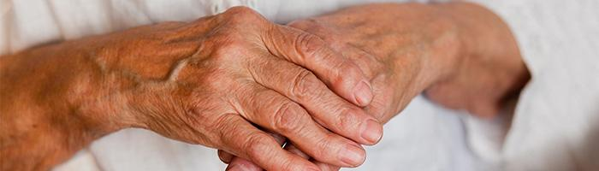
Rheumatoid Arthritis (RA)
When most people picture arthritis in their heads, then often think of reddish, swollen finger joints that slightly deform the finger shape, which is the most common symptom with rheumatoid arthritis like the image below which pictures a moderate case

Slide 11
Rheumatoid Arthritis….what is it?
Rheumatoid arthritis (RA) is an autoimmune disorder which is thought to be genetic in origin
Like all autoimmune disorders, the body mistakenly attacks itself, and in this case, it targets the lining of the joints (mostly)
In addition to joint linings, the body can also attack other structures including the eyes, skin, lungs, heart, and blood vessels
The attacks can result in permanent joint damage and deformation, loss of function, and in the cases where organs are also attacked can be quite disabling to potentially shortening lifespan

Slide 12
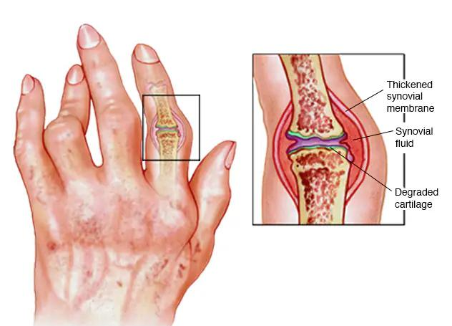
Rheumatoid Arthritis (RA)

Slide 13
Rheumatoid Arthritis….what is it?
RA symptoms usually start with pain and swelling in the small joints in the fingers and toes and most commonly starts in middle age
As the condition progresses, symptoms will show up in larger and larger joints, and in about 40% of sufferers symptoms show in other structures including the skin, eyes, lungs, heart, kidneys, glands, nerves, bone marrow, and blood vessels
The symptoms may wax and wane, and even go dormant for periods of time, before increasing again in what’s called a “flare up”
Long term and unmanaged RA can cause joints to deform and shift out of place, most notably in the hands and feet (see next slide for stages)

Slide 14
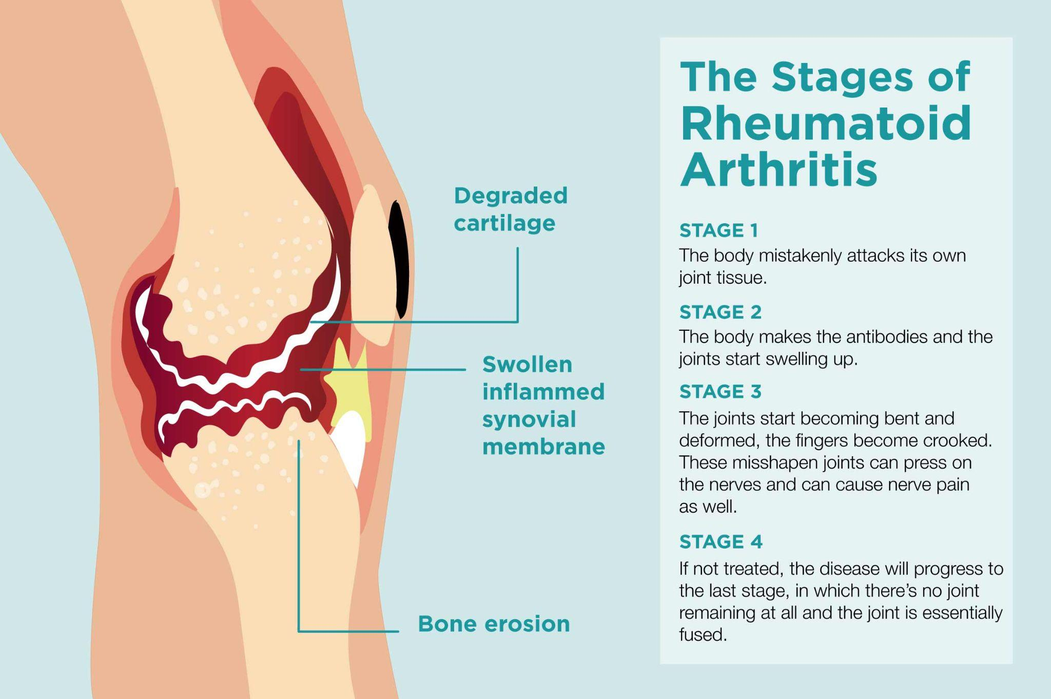

Slide 15
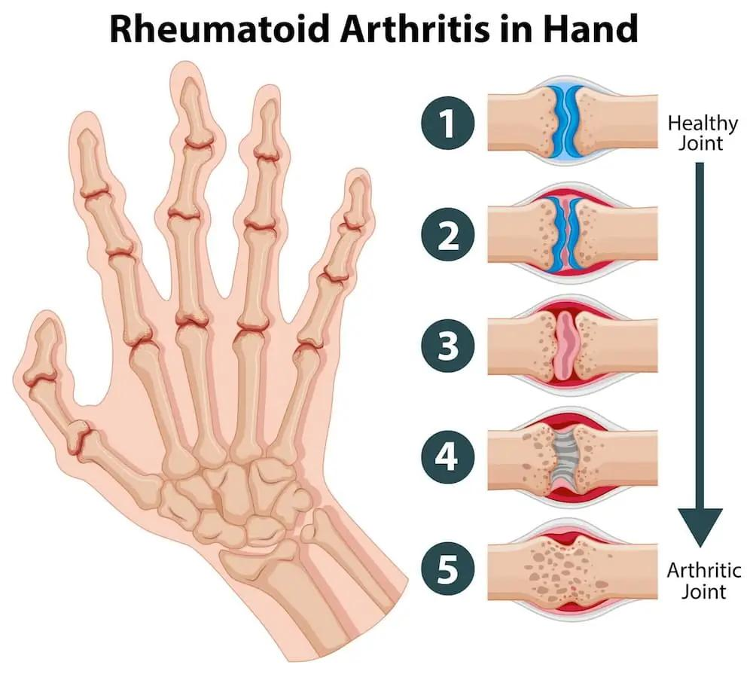

Slide 16
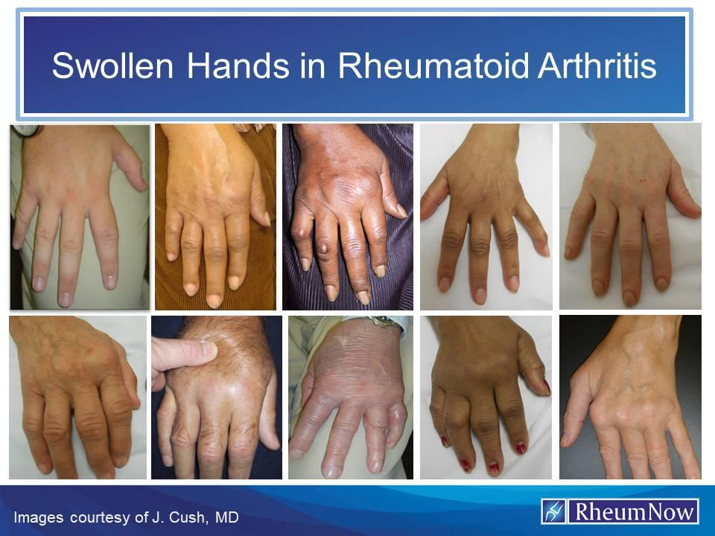

Slide 17
Rheumatoid Arthritis…is massage helpful?
Anecdotally, massage therapy doesn’t generally do much to relieve RA symptoms, and can actually cause a flare up and make them worse
Personally, I’ve worked with many RA clients and while some do find massage therapy to be helpful the majority don’t and report back feeling “beat up” and worse for several days with no feeling of relief afterwards
If you have a new client who has a known RA diagnosis, my advice is to let them know that statistically massage therapy might not be the best fit for their needs, and that starting with lighter to medium pressure for a first session is more likely to help them than deep pressure

Slide 18
Rheumatoid Arthritis…is massage helpful?
If they do get relief from a 1st session than they may be in the minority of RA clients who pair well with massage therapy
If they don’t seem to get much relief from a lighter to medium session, they may want to try a deeper pressure session to see how they react to that. Some RA clients do pair well with deep pressure but they are definitely in the minority.
For clients who don’t get any relief at all from massage therapy, I’d advise that they try acupuncture next as that does have a better track record of helping RA

Slide 19
Rheumatoid Arthritis…is massage helpful?
Since RA attacks joints, mixing in gentle ROM techniques, movement of the affected joints, and light stretching can work better than more traditional massage techniques
However, be careful not to stretch all the way to the end ranges of joints as that may further damage the joint capsules - instead try circular “flushing” movements that are light and easy in the middle ranges of motion for the joints, especially in the fingers, toes, wrists, and ankles
Other techniques that will relax the entire nervous system can also be helpful - the goal of any treatment should be to lower stress levels which can trigger attack flares, and to flush out inflammation

Slide 20
Rheumatoid Arthritis…is massage helpful?
Since RA is an autoimmune condition and flare ups will lead to permanent and disabling joint damage, supporting clients to work with a Rheumatologist who can prescribe medications is important
Medications for RA including biologics that suppress the immune system have come a long way in the past few decades and especially in the last 10 years
While being on an immunosuppressant is a compromise that has some potentially side effects and drawbacks, controlling and preventing RA flare ups statistically leads to far better long term health outcomes and is currently the best option available for most clients

Slide 21
Medication Classes & Overview
Many autoimmune conditions including RA and PsA have newer medications that suppress the attacks and therefore prevent flare ups…when available these are important parts of a client’s treatment as they provide the strongest support for long term health.
  Biologics such as Enbrel, Humara, Rinvoq, Cosentyx, Otezla and others each of which suppress various parts of the immune system are examples of these
  In general these medications need to be taken for the rest of a client’s life
  Sometimes the body stops reacting to one form of these medications and a client will need to switch to another type

Slide 22
Medication Classes & Overview
In addition to biologics to prevent flare up, more traditional medications are often used as needed such as:
  Over the counter and prescribed Nsaids
  Steroids such as prednisone

Slide 23
Rheumatoid Arthritis…is massage helpful?
Next, we’ll talk about a related disorder, Psoriatic Arthritis…but first, any questions so far about RA?

Slide 24
Massage for Arthritis
Psoriatic Arthritis

Slide 25
Psoriatic Arthritis (PsA)
PsA is a chronic inflammatory condition (I have this!) that generally affects the lining of the joints, but can also affect a wide variety of tissues including the skin, eyes, lungs, heart and blood vessels. PsA and RA have many common symptoms but some notable differences as follows.
Signs and symptoms of psoriatic arthritis may include:
Painful joints (but not usually warm and swollen like with RA)
Joint stiffness that is usually worse in the mornings and after inactivity
Foot and low back pain
Plaque psoriasis (patchy flaky skin pictured in next slide)

Slide 26
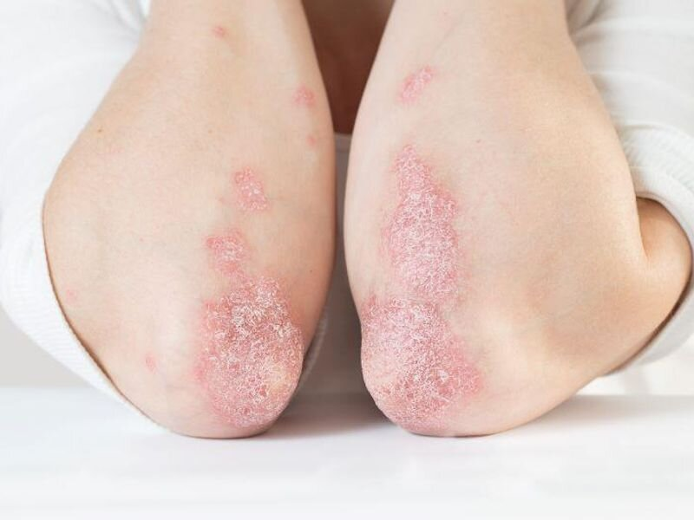

Slide 27
Psoriatic Arthritis….what is it?
Like RA, Psoriatic Arthritis (PsA) is also an autoimmune disorder which is thought to be genetic in origin
Like all autoimmune disorders, the body mistakenly attacks itself, and in this case, it targets the lining of the joints (mostly)
In addition to joint linings, the body can also attack other structures including the eyes, skin, lungs, heart, and blood vessels
The attacks can result in permanent joint damage and deformation, loss of function, and in the cases where organs are also attacked can be quite disabling to potentially shortening lifespan

Slide 28
Psoriatic Arthritis (PsA)
Earlier in life this disorder tends to affect the skin first, however, some clients don’t experience skin conditions and only experience the joint pain during flare ups (which can get misdiagnosed as RA)
PsA is different than typical osteoarthritis (caused by wear and tear) in that it is systemic and when the disorder has a flare up, all joints might be affected
New medication treatments can help keep flare ups from occurring but don’t work for everyone
Severe and/or untreated cases can cause physical disabilities

Slide 29
Psoriatic Arthritis….what is it?
PsA symptoms, like RA, usually start with pain and swelling in the small joints in the fingers and toes and most commonly starts in middle age
As the condition progresses, symptoms will show up in larger and larger joints and can include spondylitis symptoms affecting the joints in the spine and pelvis resulting in low back and hip pain
The symptoms may wax and wane, and even go dormant for periods of time, before increasing again in what’s called a “flare up”
These flare ups can be controlled by immunosuppressants and this is currently the best medical treatment to prevent the long term negative effects

Slide 30
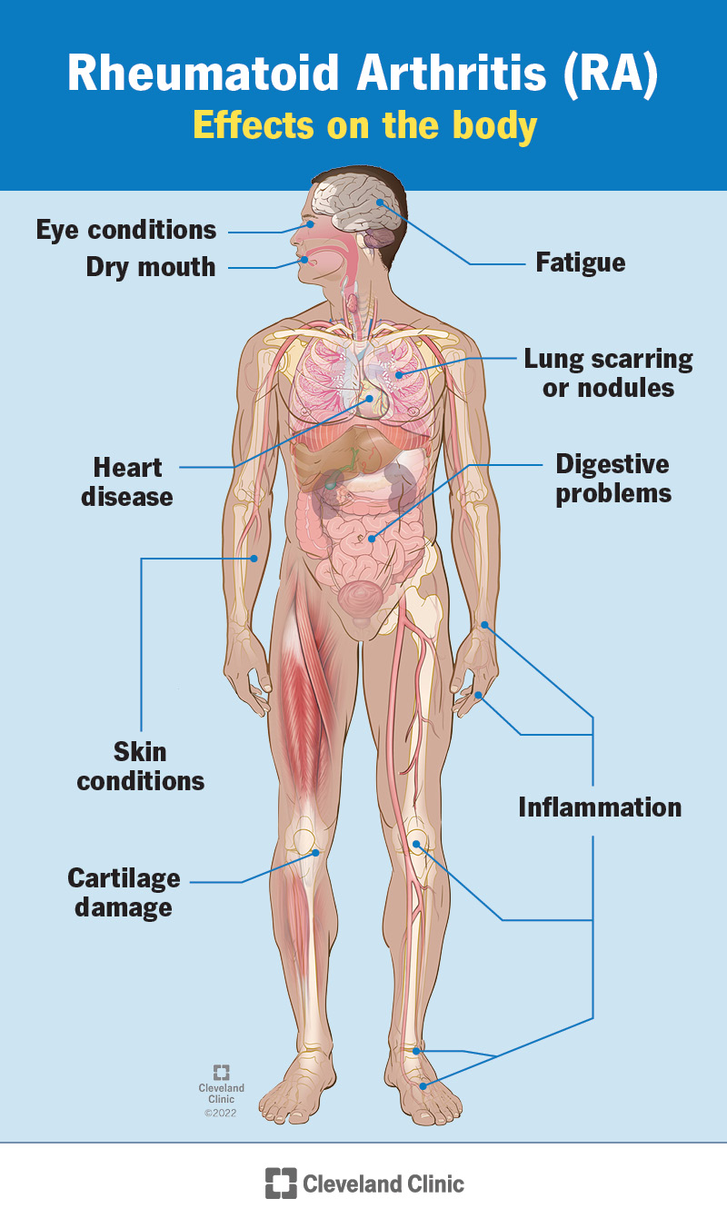

Slide 31
Psoriatic Arthritis…is massage helpful?
Unlike RA, anecdotally, a majority of PsA sufferers do find that traditional deep massage does provide long term relief and relieves symptoms
Like RA, massage treatments should include some ROM work on joints as well as stretching
For the minority of clients that don’t get great results with massage therapy, other forms of treatments may work better for these clients such as acupuncture, chiropractic adjustments, and physical therapy
Communication with the client is very important and they should be made aware that massage should be but might not be a good fit for them

Slide 32
Psoriatic Arthritis…is massage helpful?
Since PsA is an autoimmune condition and flare ups will lead to permanent and disabling joint damage, supporting clients to work with a Rheumatologist who can prescribe medications is important
Medications for PsA including biologics that suppress the immune system have come a long way in the past few decades and especially in the last 10 years
While being on an immunosuppressant is a compromise that has some potentially side effects and drawbacks, controlling and preventing flare PsA ups statistically leads to far better long term health outcomes and is currently the best option available for most clients

Slide 33
Psoriatic Arthritis…is massage helpful?
Next, we’ll talk gout…but first, any questions so far about PsA?

Slide 34
Massage for Arthritis
Gout

Slide 35
Gout
Gout is an inflammatory condition that causes arthritis in joints due to a buildup of uric acid crystals in the joint tissues
Uric acid is created in the blood when the body breaks down purines which are found naturally in the body and also in certain foods
If there is too much uric acid, it can form sharp needle like crystals which affect the joints causing pain, inflammation, and swelling

Slide 36
Gout
Once formed, the crystals cause joint pain, which if left untreated, can cause permanent damage to the joint
Unlike the autoimmune forms of arthritis, gout is usually highly treatable with diet and exercise
While damaged joints will likely never be 100% better, changes in diet to avoid foods rich in purines is generally enough to prevent future flare ups and attacks

Slide 37
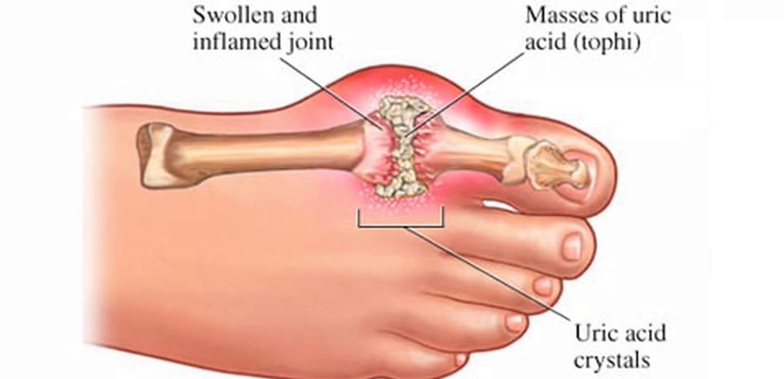

Slide 38
Gout…is massage helpful?
In general, gout attacks tend to show up in the feet, possibly due to the pooling effect of gravity on the flow of blood throughout the body
Gout also tends to act more locally as opposed to systemically
Massage treatments may need to treat the affected joints more like RA (ie light pressure and ROM) but the rest of the body should respond normally to deep tissue massage

Slide 39
Gout…is massage helpful?
Next, we’ll talk the less common types of arthritis…but first, any questions so far about gout?

Slide 40
Massage for Arthritis
Less Common types - a brief primer

Slide 41
The Common (& Less Common) Types of Arthritis
Common
Osteoarthritis (affects an estimate 15% of people over 30)
Gout (affects about 4% of the population)
Rheumatoid Arthritis (affects about 1% of the population)
Psoriatic Arthritis (affects nearly 1% of the population)
Less Common
Ankylosing Spondylitis (affects about 1 in 1,000)
Juvenile idiopathic arthritis (affects about 1 in 1,000)
Reactive Arthritis (affects about 1 in 250,000)

Slide 42
Ankylosing Spondylitis
Ankylosing Spondylitis is an inflammatory disorder similar to PsA that affects the joints of the spine and sometimes the ribs
Left untreated, the vertebral joints degrade and fuse together, limiting ROM and movement and leading to back, hip, and shoulder pain, and sometimes restricted breathing (see next slide)
Ankylosing Spondylitis tends to pair very well with massage therapy, especially any techniques and sequences that help to decompress the lumbar spine

Slide 43
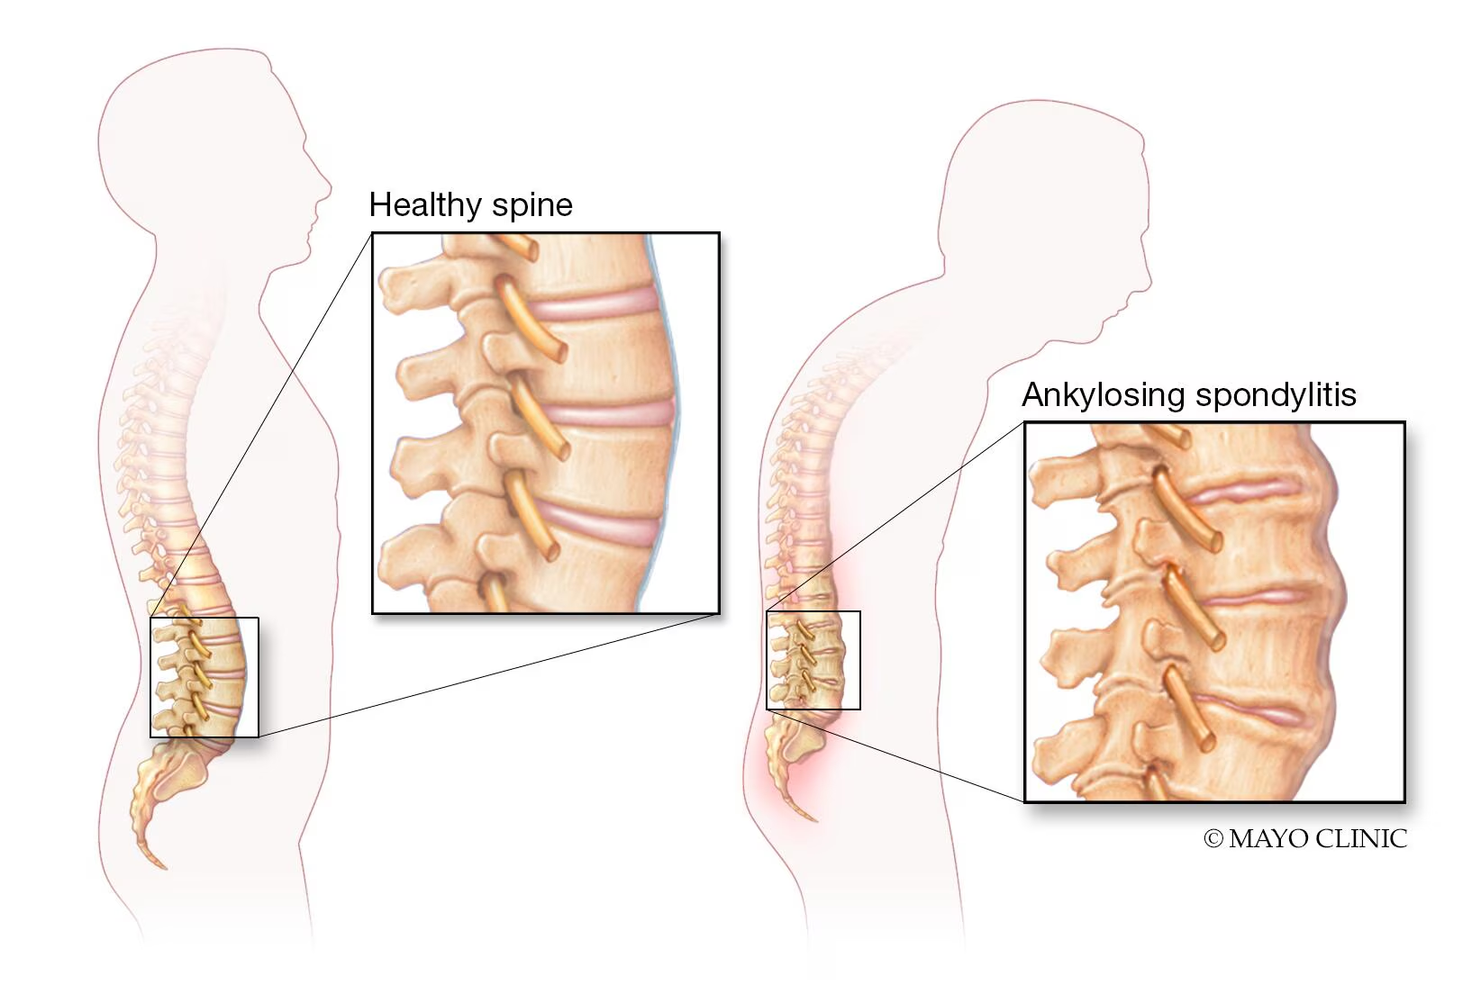

Slide 44
Juvenile idiopathic arthritis
Juvenile idiopathic arthritis is an inflammatory disorder causing joint pain and other symptoms
As the name suggest, it affects children, and we currently don’t know what causes it
There is not specific test that can determine if it’s present
It can be treated with the same medications used for RA and PsA
While physical therapy to keep joints mobile is usually prescribed, the population this affects is usually too young to want massage therapy treatments

Slide 45
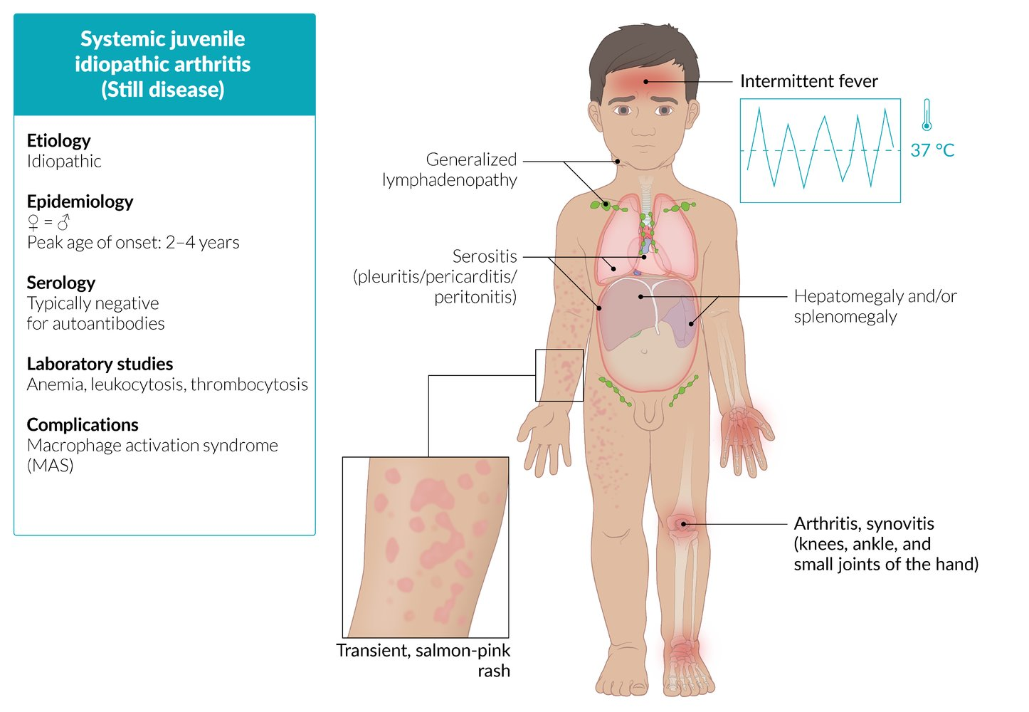

Slide 46
Reactive Arthritis
Reactive arthritis is a rare inflammatory side effect from a bacterial infection
It can show up within days to weeks after an infection and sometime affects the joints for weeks to months afterwards
Physical therapy to keep joints mobile is usually prescribed, and as long as the infection has been cleared, massage therapy usually provides relief and is not contraindicated

Slide 47
Next, we’ll cover osteoarthritis…but first, any questions so far about any of the less common forms?

Slide 48
Massage for Arthritis
Osteoarthritis

Slide 49
Osteoarthritis
Osteoarthritis is the most common form of arthritis and is due to local wear and tear overuse injury that breaks down the normal cartilage coating the protects the bones in a joint. It can have multiple causes, but is not systemic in nature.
Signs and symptoms of osteoarthritis may include:
Painful joints (but not usually warm and swollen like with RA)
Joint stiffness that is usually worse in the mornings and after inactivity
Tenderness to the touch around the affected joint
Swelling
Loss of ROM
A grating sensation
Bone spurs

Slide 50
Osteoarthritis
It tends to affect joints that are used the most or that have received an injury such as a sprain, strain, or bone break most commonly the hands, knees, hips, and spine
Once the joint structures have been damaged, this damage cannot be reversed (at least with current medicine), but symptoms can be well managed with massage therapy, exercise, and other treatments
Treatments in general, and massage therapy specifically, should focus on restoring ROM to the joint and working on surrounding tissues to help take pressure off the joint to prevent or slow further damage

Slide 51
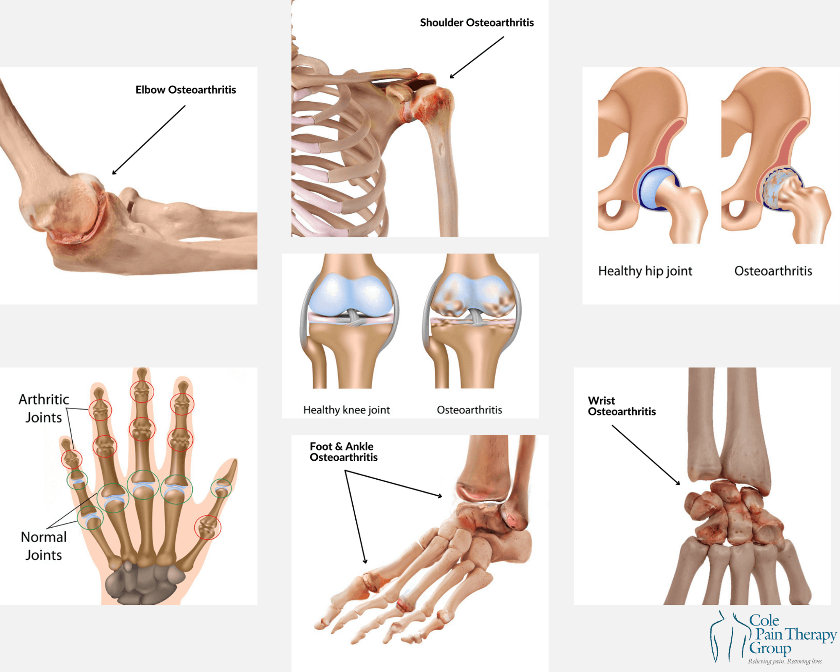

Slide 52
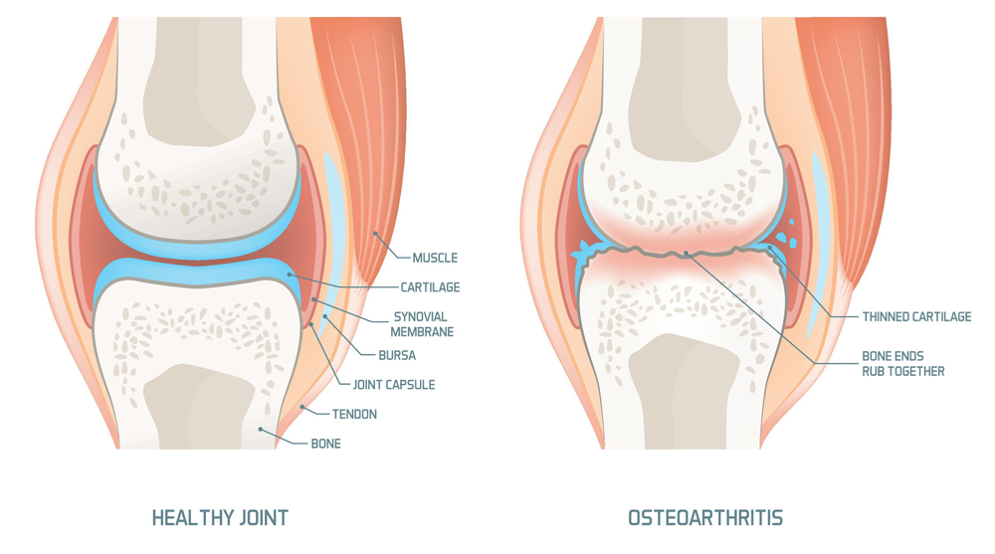

Slide 53
Osteoarthritis
A combination of massage therapy and physical therapy pair very well together to manage the symptoms of osteoarthritis and work synergistically in the following way:
Physical therapy works the strengthen the muscles that support the joint, as well as smooth any rough edges and smaller bone spurs that have formed on the bones due to loss of cartilage
Massage therapy works to decompress the joint spaces, allow better ROM to the joint, and also take pressure off of the joint from surrounding tissues and fascial lines

Slide 54
Osteoarthritis
The goals of a 1st massage therapy treatment should (at minimum) work all muscles attaching to the affected joint(s) looking to create space in the joint capsule by relieving tightness and pressure
Make sure to work on each and every muscle attached to and crossing the joint as any of them could be putting excess pressure on the joint
In advanced work, try to determine which muscles affecting the joint are tighter and which ones are weaker and use myofascial release techniques to lengthen and release the tighter muscles and rebalance the joint

Slide 55
Osteoarthritis
The goals of a subsequent massage therapy treatment should repeat the localized work around the affected joint(s) and also start working on more distal areas of the body where tension may be putting excess pressure on the affected joint
For example, knee osteoarthritis is one of the most common forms. A 1st session should definitely focus mainly on the affect joint and surrounding musculature, but subsequent sessions should look to improve ROM and function of the feet, ankles, hips, and eventually also ribcage, shoulders, and head position with the goal of lightening the load on the affected joint to whatever degree is possible

Slide 56
Techniques You May Want to Use More of…
For sure, traditional Swedish and deep tissue massage techniques are going to provide a fair amount of relief on the affected joints
However, if you are mainly using those in your work, consider learning (or re-learning) and incorporating more of the following in your sessions:
  Traction techniques that help to decompress joints
  Stretching and ROM techniques
  PNF style active release techniques
  I’ll include links to some of our videos on our Youtube channel that teach these in the course page

Slide 57
Techniques You May Want to Use More of…
In addition, it is a good idea to familiarize yourself with self care practices that you can give to clients that will help provide relief between sessions and help prevent further joint damage including:
  Hydrotherapy (hot and cold) practices, especially contrasting between hot and cold
  Specific stretches for the joint that are less known (such as how to stretch the 2nd head of biceps femoris for knee pain) (I’ll demonstrate this one….)
  New self care devices such as the HypericeX knee (or shoulder) devices that are wearable devices that provide hot and cold (I’ll show this)
  Compression devices such as the Jet Boots by Therabody that repeatedly flush the area with blood flow to increase healing times (I’ll show this)

Slide 58
Next, we’ll cover how to improve your language and intake…but first, any questions so far about osteoarthritis?

Slide 59
“Fixing” vs “Supporting”
Adjust your language when working with arthritis clients

Slide 60
Unfortunately, there is scant scientific study on massage therapy and these conditions
Due to the fact that many of these conditions are only recently being classified and discovered, science on whether massage can help with them is largely non-existent
Figuring out what works and doesn’t is going to be on a case by case basis with some broad guidelines that can help provide direction

Slide 61
In General if a client is healthy enough to exercise, massage will be a good fit
Conditions that are well managed through medication and allow a client to engage in normal activities such as exercise or physical therapy are usually a good match for massage therapy
Disorders that cause high fatigue or abnormal inflammation may not pair well with massage during an active flare up but may be helped by massage between flare ups

Slide 62
There is currently no “cure” for arthritis
Each condition has its own set of triggers and symptoms and can vary widely from client to client
Massage therapy and other treatments are meant to manage symptoms and cannot directly affect the underlying conditions
For the systemic versions, some newer medications such as biologics and other immunosuppressants can control both their symptoms and more importantly significantly lower and prevent flare ups, preventing permanent tissue damage and loss of function in the body.

Slide 63
There is currently no “cure” for arthritis
It is vital that we set aside any anti-medication biases we may have as alternative medicine practitioners and acknowledge that our opinions on medication are not relevant and outside our scope of practice
Leading clients to believe that they can avoid medications that help control flare ups can be detrimental to the client’s long term health
Our language should be clear on how massage therapy may (or may not) help with these conditions and that we are providing support in addition to helping with the more common aches and pains that all clients have and that autoimmune sufferers may have more of

Slide 64
Intake Considerations
If a client arrives and tells you about a condition that you have never heard of before, it’s worth taking a moment to do some on the spot online research to gain a basic understanding of it.
Stick to well known and respected sources such as the NIH or a renowned non-profit foundation that is focused on their specific condition such as the Arthritis Foundation.
You certainly don’t need to find out every known detail about the condition but it helps a lot to understand the main symptoms and the types of body tissue(s) that the condition attacks during flare ups.

Slide 65
Intake Considerations
It’s also worth noting any secondary symptoms that go along with the condition such as headaches, fatigue, anxiety, etc.
These clients are used to doctors doing this and you don’t need to try to pretend you know everything about all conditions.
The rarer the condition the more likely that the client themselves has done their own reading and discussed massage therapy with their medical care team.

Slide 66
Intake Considerations
Ask clients if they have previous experience getting massage and what sorts of techniques they know will bring them relief. And if there are any techniques that have aggravated their symptoms.
Knowing their prior experience will help you craft a treatment that is most likely to help them and least likely to harm them.
If it’s a condition that you are already familiar with, be transparent about whether massage (and your style specifically) has helped your other clients with that condition and what sort of approaches you’ve developed based on your experience.

Slide 67
Intake Considerations
And ask them to be honest with themselves and you about the results after a first session to help you better craft their future sessions (especially with RA clients where you may need to help them decide to try something besides massage)
Most of these clients are in the middle of the process of learning about their condition and are willing to experiment with different treatments to see what works best for them.
While I may recommend starting light to medium (especially for RA) the client may still choose to try out a deeper tissue session to find out for themselves if they are in the subset of clients that do get good results from it for their condition.
Or they may choose to opt to start with lighter work with me. I let them make the choice about where to start.

Slide 68
Intake Considerations
You will likely run into clients with active flare ups and symptoms profiles that haven’t had their autoimmune conditions formally diagnosed.
These symptom profiles can sometimes look similar to our other clients such as back pain, neck pain, headaches, etc.
While we are not qualified to diagnose clients under our licensure, you will help a lot more people by getting more familiar with assessing possible autoimmune disorders and getting more comfortable referring clients to a rheumatologist.
And providing encouragement and support to help them follow through and get a real diagnosis.

Slide 69
Some things that can indicate that a referral is warranted
Symptoms that seem systemic and affect most joints in the body
Symptoms that don’t seem to respond to massage in the same way as with the majority of your clients or don’t get any better after a few sessions
Bilateral symptoms that affect the feet and hands such as neuropathy, tingling, itching, pain, swelling, etc.

Slide 70
Massage for Arthritis
Q & A
How to download slides, get your certificates, when video will be available

